Slide 1
HIVE
Sundharakumar KB
Department of Computer Science and Engineering
School of Engineering
Shiv Nadar University Chennai

Slide 2
HIVE
Hive is a data warehouse infrastructure based on Hadoop framework
Suitable for data summarization, analysis and querying.
Uses SQL like syntax called as HQL – Hive Query Language.
Hive uses mapreduce and HDFS for processing and storage/retrieval.
Notes:
OLTP, OLAP – DW; Hadoop -> hive

Slide 3
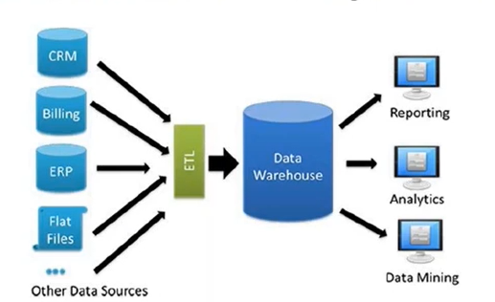
HIVE

Slide 4
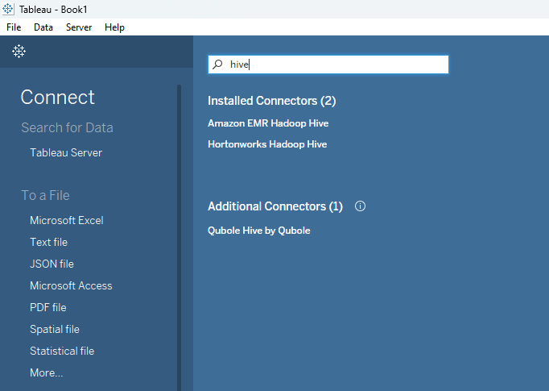
Advantages of HIVE
Can be used as ETL tool.
Can handle large datasets.
SQL(filters, joins, groupby) on top of map and reduce.
Provides integration support to BI tools.

Slide 5
Where not to use Hive
Don’t use hive if:
The data size doesn’t cross GBs.
Creating schema from the data is not possible
RDBMS can solve the problem, don’t invest time in Hive.
For low latency applications and for low response time.

Slide 6
Similarity with SQL & Differences
Similarity: HiveQL is very similar in syntax to SQL. It is based on SQL-92 framework and acts as SQL for DFS.
Difference: the query is executed on Hadoop infra (cluster) than a traditional RDBMS.
This allows hive to scale and handle huge datasets.
Internal execution of hive queries is a series of automatically created map-reduce tasks.
All hive queries are converted to mapreduce.. Why not straightaway write MR codes?
To do this, internals of Hadoop framework is required. However, people with SQL knowledge can simply write hive queries to get the results.

Slide 7
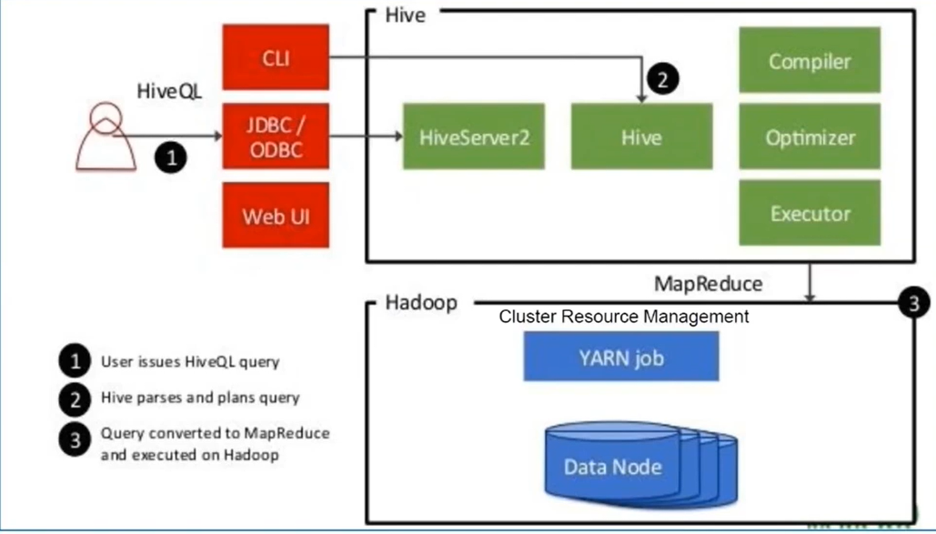
Hive Architecture
Notes:
HiveServer2 is a thrift server which is a thin Service layer to interact with the HDP cluster in a seamless fashion. It supports both JDBC and ODBC driver to provide a SQL layer to query the data. An incoming SQL query is converted to either TEZ or MR job, the results are fetched and send back to client

Slide 8
Hive Architecture
By default, Hive uses embedded metastore; this means the metadata is stored in the built-in Derby database.
You can configure your own database as a metadata storage for Hive – eg: MySQL.
Data in hive is organised into three categories:
Tables
Partitions
Buckets

Slide 9
Sample Queries
Show databases;
Show tables;
Create database sample;
Use sample;
Create table emp (emp int, name string, city string)
ROW FORMAT delimited fields terminated by “,” LINES TERMINATED BY “\n” STORED AS TEXTFILE;

Slide 10
Sample Queries
Insert into emp (sno, name, city) values (1, ‘sample’, ‘Chennai’);
Load data local inpath ‘/home/Sundharakumar/Desktop/sampletxns.txt’) into table emp;
Desc emp;
Select * from emp; -> no mapreduce
Select count(*) from emp; -> mapreduce
Load data inpath ‘/samplehive/sampletxns.txt’) into table emp;

Slide 11
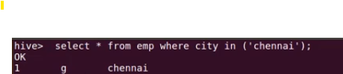
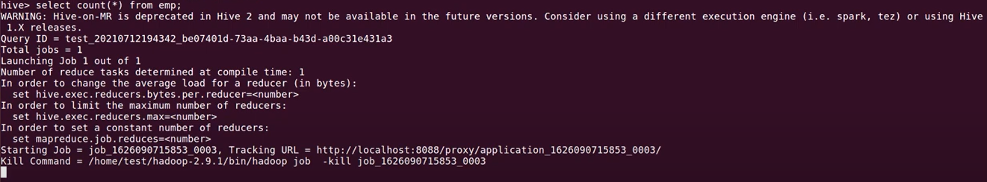
Sample Queries

Slide 12
Partitions
Partitions:
Each table can be broken into partitions
Partitions determine distribution of data within subdirectories
Static and Dynamic Partitioning
CREATE_TABLE Sales (sale_id INT, amount FLOAT)
PARTITIONED BY (country STRING)
Insert into sales partition (country=‘India’) select sale_id, amount from sales_nopart where country=‘India’

Slide 13
CREATE_TABLE Sales (sale_id INT, amount FLOAT)
PARTITIONED BY (country STRING)
Set hive.exec.dynamic.partition.mode=nonstrict;
INSERT into sales partition (country) select sale_id, amount from sales_nopart where country=‘India’;

Slide 14
Buckets
Buckets
Can speed up queries that involve sampling the data
Sampling works without bucketing, but Hive has to scan the entire dataset
Use CLUSTERED BY when creating table
For sorted buckets, add SORTED BY
Data can be divided into buckets
Based on a hash function of the column
H(column) mod NumBuckets = bucket number
Each bucket is stored as a file in partition directory
Set.hive.enforce.bucketing = true;

